Slide 1


INTEGRATED PROJECT – SUMMER 2024
Introduction to Principal Component Analysis (PCA)
Team Arocha
Actuarial Science Program
May 31, 2024

Slide 2
TABLE OF CONTENTS
01 | The Need for Dimensionality Reduction
02 | What is PCA?
03 | What are the steps to PCA?

Slide 4
Why is it Necessary to Reduce Dimensionality?
In machine learning, multiple features about each data point are collected to get more accurate results
As the number of features increases, the performance of the model is higher (up to a certain point!)
At that certain point, adding additional features may actually decrease performance and add computational complexity (aka, “the curse of dimensionality”)
Not all features may be relevant—some will add a minimal effect and can be removed
Dimensionality Reduction techniques are used to remove features and transform the data into lower dimensions, while keeping most of the information intact

Slide 5
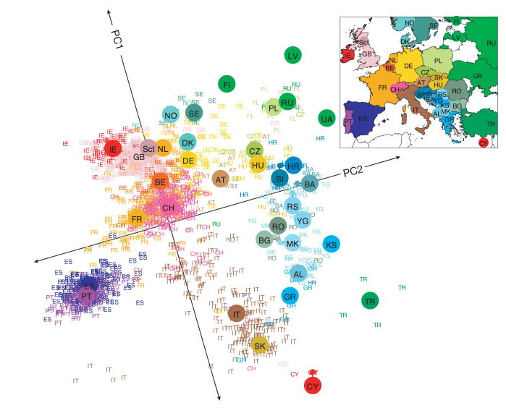

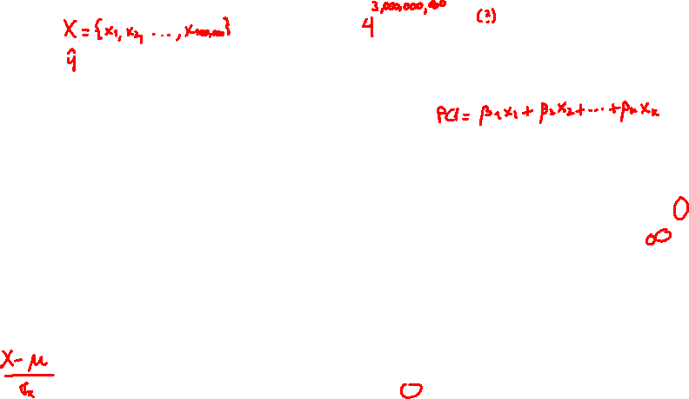
What is PCA?
PCA is a dimensionality reduction technique that transforms data into a lower-dimensional space by projecting the data onto new lower-dimensional axes
Benefits
Easier visualization
Noise reduction
Improved computational efficiency
Applications
Image processing
Finance
Genetics
...
Assumptions
Linear relationships between variables
Sensitivity to scaling: it is important to standardize the data
Interpretability: principal components are less interpretable than original features
Source: Novembre, J., Johnson, T., Bryc, K. et al. Genes mirror geography within Europe
Nature 456, 98–101 (2008). https://doi.org/10.1038/nature07331

Slide 6





PCA Algorithm
1 Standardize the data
Center data by subtracting the mean
Scaling to unit variance
2 Compute the covariance matrix
Measure the relationship between features
3 Calculate eigenvalues and eigenvectors
These are obtained from the covariance matrix
4 Sort eigenvalues and select principal components
Order eigenvalues and choose the top $k$ eigenvectors
5 Transform the data
Project the original data onto the selected principal components

